Slide 1

1. Introduction to Software Engineering

Slide 2
Outline
What is software
Software is Everywhere
Software Crisis and Software Failures
From Software Development to Software Engineering
Development Activities
Chapter 1

Slide 3

1. What is software
Notes:
Firstly, before we delve into the detail of the SE, lets see a very simple question

Slide 4
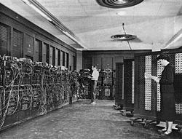
1.1 Software vs. Hardware
Hardware-the physical components of the computer
Software- programs that run on the hardware
The first general-purpose electronic computer, ENIAC
After the program was figured out on paper, the process of getting the program "into" the ENIAC by manipulating its switches and cables took additional days.
Glen Beck (background) and Betty Snyder (foreground) program the ENIAC in BRL building 328. (U.S. Army photo)
Notes:
Obviously, software is defined in terms of it’s difference between hardware
A Joke:
1. The easiest way to tell the difference between hardware and software is to kick it. If it hurts your toe, it’s hardware.
Carl Farrell
Before Eniac, software can not be separated from the hardware, i.e., the software can only works on its hardware.
In the 1940s, 1950s, and 1960s, men often filled the more prestigious and better paying hardware engineering roles, but often delegated the writing of software to women

Slide 5
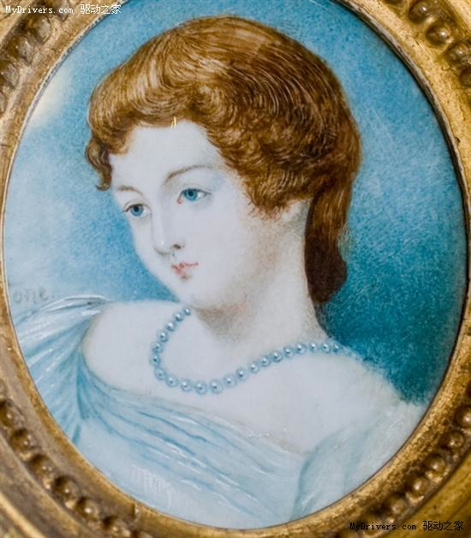
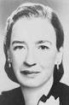
Ada Lovelace
（1815-1852）
Grace Murray Hopper (1906-1992)
The First Programmer
The Inventor of Cobol
Woman and Software Engineering
Notes:
Although male programmers are majority in software industry now. From the historical view of software engineering, woman contributed a lot.

Slide 6
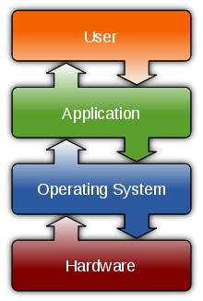



1.2 Software Types
System Software
It includes the Operating System and all the utilities that enable the computer to function.
Application Software
It includes programs that do real work for user.
Open Source Software
It is computer software whose source code is available under a license that permits users to use, change, and improve the software, and to redistribute it in modified or unmodified form
Proprietary Software (non-free software )
It is software with restrictions on using, copying and modifying as enforced by the proprietor. Restrictions on use, modification and copying is achieved by either legal or technical means and sometimes both.
Notes:
This classification is changing because Internet has become a software platform. Many applications runs above a Web OS.
Operating System can run on virtual machine, instead of on the hardware directly.

Slide 7
1.3 Software vs. Program
“computer software, or just software, is a collection of computer programs and related data that provide the instructions for telling a computer what to do and how to do it”
From wikipedia
Software =
Programs + Data + Associated Documentation

Slide 8
1.4 Software Characteristics
Software is developed or engineered, it is not manufactured in the classical sense
Software doesn’t wear out
Although the industry is moving toward component-based assembly, most software continues to be custom built
Failure Rate
Increased failure rate due to side effects
Failure Rate
Wear out
Actual curve
Infant mortality
Idealized curve
Change
Time
Time
Notes:
Bathtub /ˈbæθˌtʌb/ curve
It indicates that hardware exhibits relatively high failure rates early in its life; defects are corrected and the failure rate drops to a steady-state level for some period of time. As time passes, the failure rate rises again as hardware components suffer from the cumulative affects of dust, vibration, abuse, temperature extremes and many other environmental maladies
Software is not susceptible to the environmental maladies that cause hardware to wear out. In theory therefore, the failure rate curve for software should take the form of the “idealized curve”. Undiscovered defects will cause high failure rates early in the life of a program. However, these are corrected and the curve flattens as shown.
During its life software will undergo change (maintenance). As changes are made, it is likely that some new defects will be introduced, causing the failure rate curve to spike. Before the curve can return to the original steady-sate failure rate, another change is requested, causing the curve to spike again. Slowly, the minimum failure rate level begins to rise-the software is deteriorating /dɪˈtɪəriəreɪt/ due to change.

Slide 9
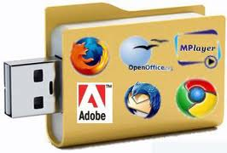
2. Software is everywhere

Slide 10
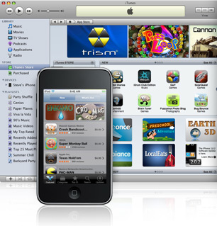
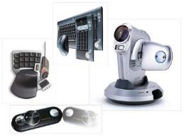
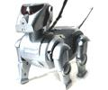
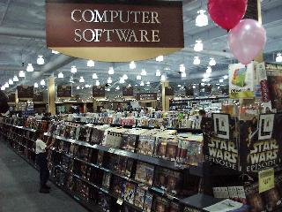
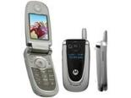
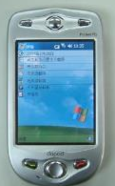

More and more systems are software controlled
Software is sold by retail
Notes:
Computer Software has become a driving force.
It is the engine that dries business decision making. It serves as the basis for modern scientific investigation and engineering problem solving. It is a key factor that differentiates modern products
It's what lets us get cash from an ATM, make a phone call, and drive our cars. A typical cellphone now contains 2 million lines of software code; by 2010 it will likely have 10 times as many. General Motors Corp. estimates that by then its cars will each have 100 million lines of code.
The average company spends about 4 to 5 percent of revenue on information technology, with those that are highly IT dependent--such as financial and telecommunications companies--spending more than 10 percent on it. In other words, IT is now one of the largest corporate expenses outside employee costs. Much of that money goes into hardware and software upgrades, software license fees, and so forth, but a big chunk is for new software projects meant to create a better future for the organization and its customers.
Governments, too, are big consumers of software. In 2003, the United Kingdom had more than 100 major government IT projects under way that totaled $20.3 billion. In 2004, the U.S. government cataloged 1200 civilian IT projects costing more than $60 billion, plus another $16 billion for military software.

Slide 11
The economies of ALL developed nations are dependent on software
Software engineering expenditure represents a significant fraction of total spends in all developed countries
Notes:
Computers and Software have impact on our culture:
New industrial revolution
Transformation from an industrial society to an “information society”

Slide 12
3. Software Crisis and Software Failures
Notes:
Although software is becoming more and more important, software industry is also facing many challenges.

Slide 13
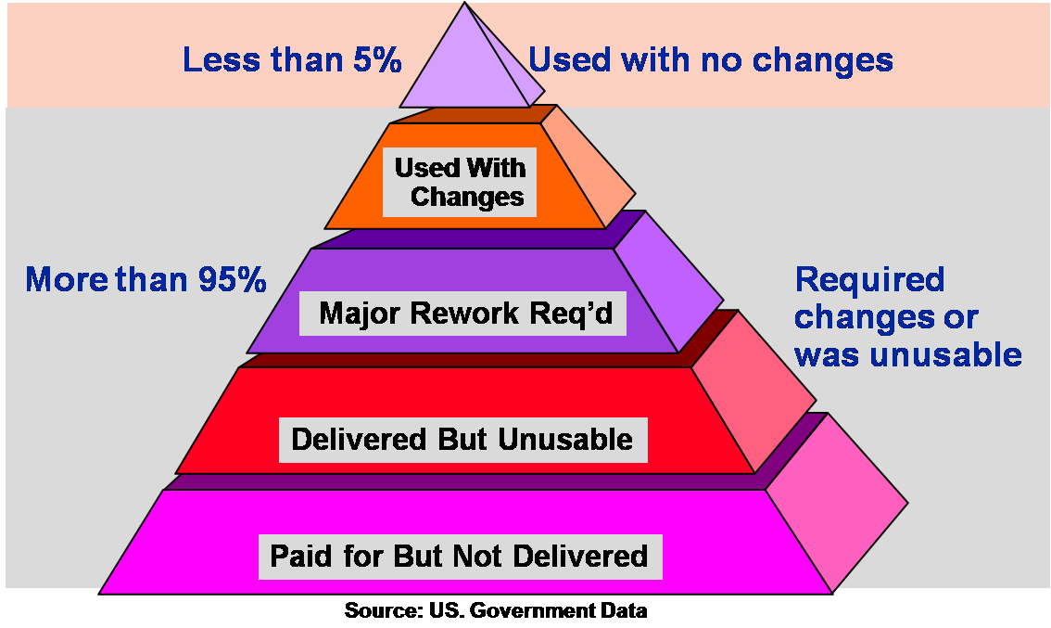
3.1 Software Crisis
The difficulty of writing correct, understandable, and verifiable computer programs
Notes:
The term "software crisis" was coined by F. L. Bauer at the first NATO Software Engineering Conference in 1968 at Garmisch, Germany.[1]
An early use of the term is in Edsger Dijkstra's 1972 ACM Turing Award Lecture
The major cause of the software crisis is that the machines have become several orders of magnitude more powerful! To put it quite bluntly: as long as there were no machines, programming was no problem at all; when we had a few weak computers, programming became a mild problem, and now we have gigantic computers, programming has become an equally gigantic problem.

Slide 14
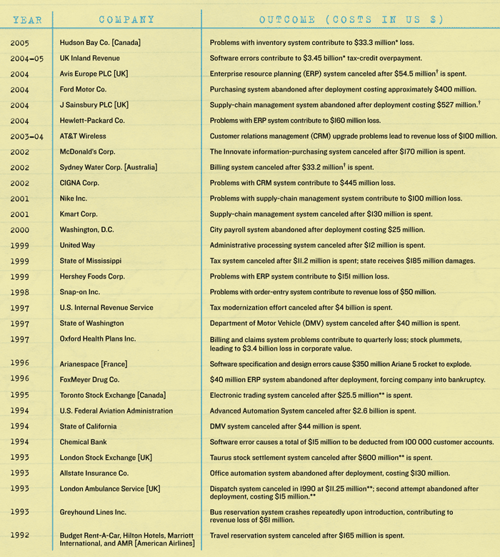
3.2 Software Failures
We waste billions of dollars each year on entirely preventable mistakes
Sources: Business Week, CEO Magazine, Computerworld, InfoWeek, Fortune, The New York Times, Time, and The Wall Street Journal.

Slide 15
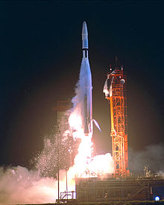
20 Famous Software Disasters
Source: http://www.devtopics.com/20-famous-software-disasters/
1. Mariner Bugs Out (1962)
Cost: $18.5 million
Disaster: The Mariner 1 rocket with a space probe headed for Venus diverted from its intended flight path shortly after launch. Mission Control destroyed the rocket 293 seconds after liftoff.
Cause: A programmer incorrectly transcribed a handwritten formula into computer code, missing a single superscript bar. Without the smoothing function indicated by the bar, the software treated normal variations of velocity as if they were serious, causing faulty corrections that sent the rocket off course
Notes:
Mariner 水手
Venus 金星

Slide 16
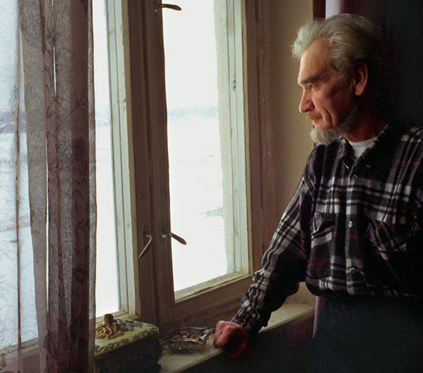
…
4. World War III… Almost (1983)
Cost: Nearly all of humanity
Disaster: The Soviet early warning system falsely indicated the United States had launched five ballistic missiles. Fortunately the Soviet duty officer had a “funny feeling in my gut” and reasoned if the U.S. was really attacking they would launch more than five missiles, so he reported the apparent attack as a false alarm.
Cause: A bug in the Soviet software failed to filter out false missile detections caused by sunlight reflecting off cloud-tops.
Notes:
ballistic missile 弹道导弹

Slide 17
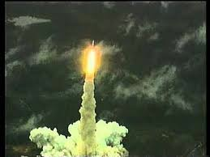
10. Ariane Rocket Goes Boom (1996)
Cost: $500 million
Disaster: Ariane 5, Europe’s newest unmanned rocket, was intentionally destroyed seconds after launch on its maiden flight. Also destroyed was its cargo of four scientific satellites to study how the Earth’s magnetic field interacts with solar winds.
Cause: Shutdown occurred when the guidance computer tried to convert the sideways rocket velocity from 64-bits to a 16-bit format. The number was too big, and an overflow error resulted. When the guidance system shut down, control passed to an identical redundant unit, which also failed because it was running the same algorithm.
Notes:
Sideway velocity: 侧向速度

Slide 18
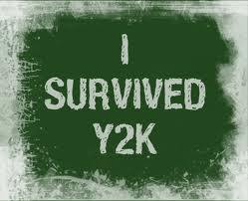
15. Y2K (1999)
Cost: $500 billion
Disaster: One man’s disaster is another man’s fortune, as demonstrated by the infamous Y2K bug. Businesses spent billions on programmers to fix a glitch in legacy software. While no significant computer failures occurred, preparation for the Y2K bug had a significant cost and time impact on all industries that use computer technology.
Cause: To save computer storage space, legacy software often stored the year for dates as two digit numbers, such as “99″ for 1999. The software also interpreted “00″ to mean 1900 rather than 2000, so when the year 2000 came along, bugs would result.
Notes:
Infamous: well known for something bad
Glitch[ɡlɪtʃ]: a small and sudden problem, especially with technology such as a computer

Slide 19
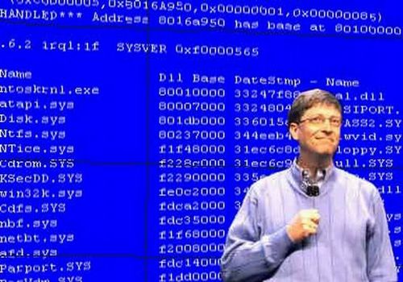
Blue Screen of Death (or BSOD) refers to the error message displayed in Microsoft Windows operating systems.
During the presentation of a Windows 98 beta at COMDEX in April 1998, the demo computer crashed as one of the assistants tried to connect a scanner in demonstrating the Windows support for Plug & Play devices. With the BSoD message on slideshow display, the audience had a big laughter and applauded, to which Mr. Gates responded: “That must be why we’re not shipping Windows 98 yet.”
Notes:
Because the BSOD message indicates an unrecoverable system crash and leaves the user no option other than rebooting the computer, it’s been both feared and ridiculed by Windows OS users since becoming introduced on Windows 3.1.

Slide 20
These problems will become worse because of the pervasive use of software in our civic infrastructure.

Slide 21
Factors affecting the success of software development
Complexity:
The problem domain is difficult
The development process is very difficult to manage
Software offers extreme flexibility
Software is a discrete system
Continuous systems have no hidden surprises (Parnas)
Discrete systems have!
Notes:
The problem domain is sometimes difficult, just because we are not experts in it. That is, because you are not an expert in it, you have to learn it.
The development process is very difficult to manage. This has taken some time and some billion dollars to learn, but we are now starting to accept the fact, that software development is a complex activity. One of the assumptions that managers have made in the past, is that software development can be managed as a set of steps in linear fashion, for example: Requirements Specification, followed by System Design followed by Implementation followed by Testing and Delivery.
In reality this is not that easy. Software Development does not follow a linear process. It is highly nonlinear. There are dependencies between the way you design a system and the functionality you require it to have. Moreover, and that makes it really tricky, some of these dependencies cannot be formulated unless you try the design.
Another issue: Software is extremely flexible. We can change almost anything that we have designed in software. While it is hard to change the layout of a washing machine, it is extremely easy to change the program running it.
Here is another problem: When you are sitting in a plane in a window seat, and you push a button to call the steward for a drink, you don’t expect the system to take a hard left turn and dive down into the pacific. This can happen with digital systems. One of the reasons: While you can decompose the system into subsystems, say “Call Steward” and “Flight Control” subsystems, if you don’t follow good design rules, you might have used some global variable for each of these subsystems. And one of these variables used by the flight control subsystem might have been overwritten by the Call Steward SubSystem.
(from Bernd Bruegge & Allen H. Dutoit’s PPT)

Slide 22
Change:
The “Entropy” of a software system increases with each change: Each implemented change erodes the structure of the system which makes the next change even more expensive (“Second Law of Software Dynamics”).
As time goes on, the cost to implement a change will be too high, and the system will then be unable to support its intended task. This is true of all systems, independent of their application domain or technological base.

Slide 23
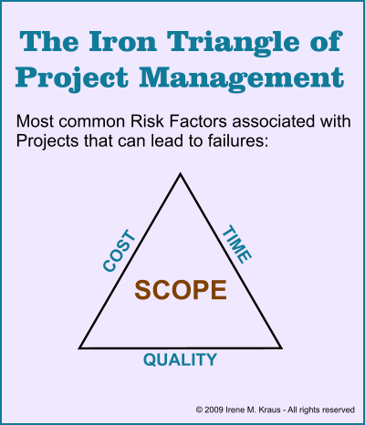
Unrealistic Expectations
Notes:
To achieve one goal is not easy and try to achieve all three conflicting goals becomes a challenge

Slide 24
4. From Software Development to Software Engineering

Slide 25
4.1 Towards the engineering of software development
How to develop high quality software under the constraints of time and cost?
software development skill training
Qualified developers recruitment
Development process reengineering
….
We need a systematic approach
Notes:
All these approaches benefit the improvement of software development. But…

Slide 26
4.2 Software Engineering
Software Engineering:
The application of a systematic, disciplined, quantifiable approach to the development, operation, and maintenance of software, and the study of these approaches; that is, the application of engineering to software. (IEEE Computer Society’s Software Engineering Body of Knowledge )

Slide 27
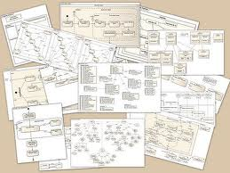
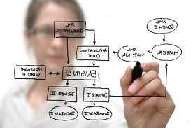
4.3 Understand the Software Engineering
1. It is a modeling activity
Model: an abstract representation of a system
Software engineers need to understand the environment in which the system has to operate
Software engineers need to understand the systems they could build, to evaluate different solutions and trade-offs
Notes:
Model driven software development
Developing model first instead of coding directly

Slide 28
Model-based software Engineering: Code is a derivation of object model
Pr
oblem Statement
:
A
stock exchange lists many companies.
Each company is identified by a ticker symbol
Analysis phase results in cbject model (UML Class Diagram):
*
*
Company
StockExchange
Lists
tickerSymbol
Implementation phase results in code
public class StockExchange
{
public Vector m_Company = new Vector();
};
public class Company
{
public int m_tickerSymbol
public Vector m_StockExchange = new Vector();
};
A good software engineer writes as little code as possible
Notes:
The ideal approach is we only define models and code can be generated directly. But the current status is we still need to transform the model to code using our knowledge

Slide 29
Models are used to provide abstractions
System Model:
Object Model: What is the structure of the system? What are the objects and how are they related?
Functional model: What are the functions of the system? How is data flowing through the system?
Dynamic model: How does the system react to external events? How is the event flow in the system ?
Task Model:
PERT Chart: What are the dependencies between the tasks?
Schedule: How can this be done within the time limit?
Org Chart: What are the roles in the project or organization?
Issues Model:
What are the open and closed issues? What constraints were posed by the client? What resolutions were made?

Slide 30
Issue-Modeling
Issue:
What is the
Center of the
Universe?
Resolution (1998):
The church declares
proposal 1 was wrong
Resolution (1615):
The church
decides proposal 1
is right
Proposal1:
The earth!
Proposal2:
The sun!
Pro:
Aristotle
says so.
Con:
Jupiter’s moons rotate
around Jupiter, not
around Earth.
Pro:
Copernicus
says so.
Pro:
Change will disturb
the people.
Notes:
Approval
Opposition
Jupiter：木星

Slide 31
The Interdependencies of Models
System Models
Object Model
Forward
Engineering
Reverse
Engineering
class...
class...
class...
Code
Functional
Model
Dynamic Model
Constraints
Arguments
Org Chart
Issues
Pro Con
PERT Chart
Proposals
Gantt Chart
Issue Model
Task Models

Slide 32
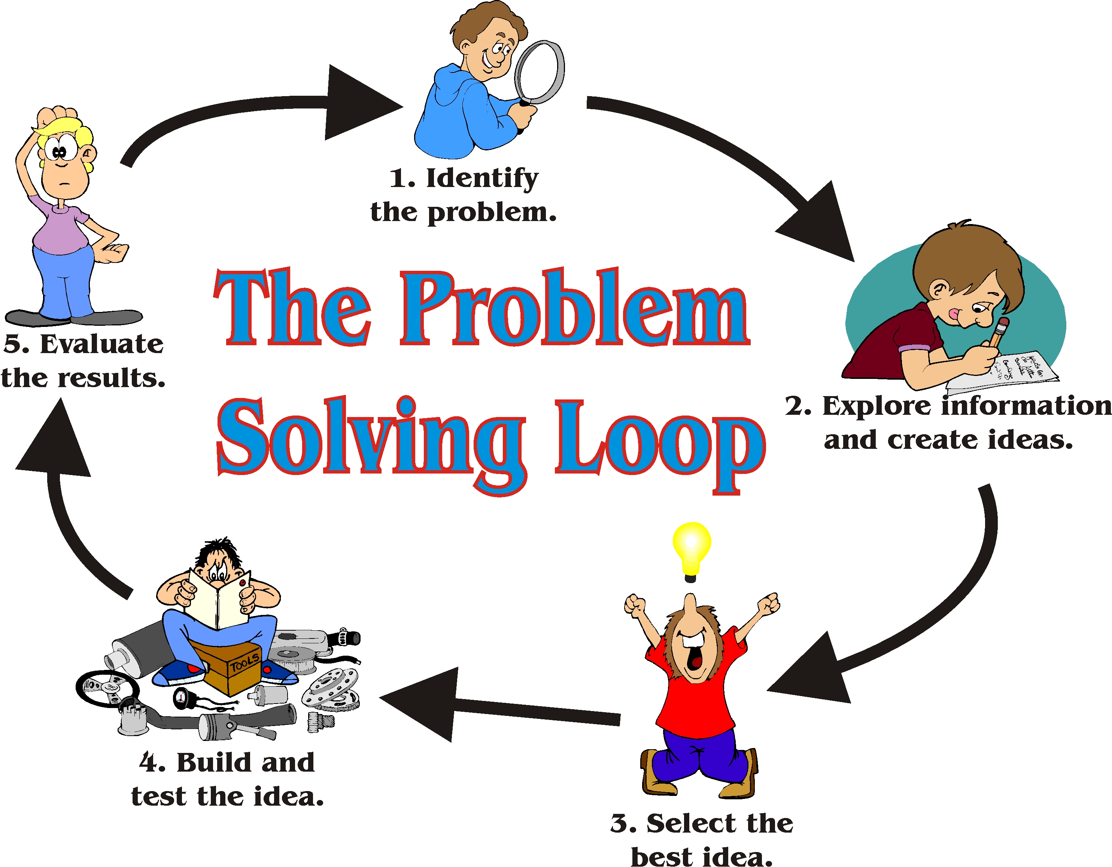
2. It is a problem solving activity
Notes:
In essence, software engineering is a engineered problem solving process which includes methodologies, technical.
We should understand the problem
We try to find useful information which can help us propose the solution
Evaluate different solutions according to a set of indexes

Slide 33
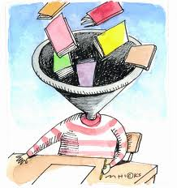

3. It is a knowledge acquisition activity
Using a Funnel for learning
It is a nonlinear process
×
Notes:
Funnel /ˈfʌn(ə)l] 漏斗
One theory our brain is like funnel, we can put everything into it, then we know what we put in
But according to our daily life experience, leaning is a nonlinear process, during which one more piece of knowledge can deny what we have learned before

Slide 34
4. It is a rational-driven activity
software engineers capture the context in which decisions were made and the rationale behind these decisions.
Rationale information, represented as a set of issue models, enables software engineers to understand the suggestion of a proposed change when returning to a decision.
Notes:
Because change happens frequently, rational should be kept to help members understand how the system was developed

Slide 35
4.4 Dealing with Complexity
The most important problems in software engineering
Abstraction: Through Modeling (Already Discussed in 4.3)
Decomposition
Hierarchical

Slide 36
(1) Decomposition
A technique used to master complexity (“divide and conquer”)
Functional decomposition
The system is decomposed into modules
Each module is a major processing step (function) in the application domain
Modules can be decomposed into smaller modules
Object-oriented decomposition
The system is decomposed into classes (“objects”)
Each class is a major abstraction in the application domain
Classes can be decomposed into smaller classes
Which decomposition is the right one?
Notes:
Which decomposition is the right one?
Functional decomposition emphasizes the ordering of operations, very useful at requirements engineering stage and high level description of the system.
Object-oriented decomposition emphasizes the agents that cause the operations. Very useful after initial functional description. Helps to deal with change (usually object don’t change often, but the functions attached to them do).

Slide 37
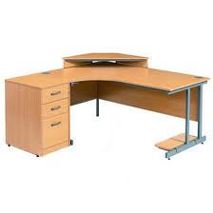

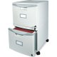
Top-Down Functional decomposition
The whole system is characterized by a single function, and then the function is decomposed into a set of functions in a process of stepwise refinement.
The System
Studying
书房
Function1
Function2
Function3
. . . . . .
Desk
Table top
Filing cabinet
Bookshelves
. . . . . .
Function11
Function12
. . . . . .
Left drawer
Middle drawer
Right drawer

Slide 38
Bottom-up Functional composition
You can have different components of functions such as that from a function library
You can compose them into a module with a more significant function.
The System
Studying
Function1
Function2
Function3
. . . . . .
Desk
Table top
Filing cabinet
Bookshelves
. . . . . .
Function11
Function12
. . . . . .
Left drawer
Middle drawer
Right drawer

Slide 39
Modules with well-defined semantics that can be directly implemented.
Data plays a secondary role
Does not necessarily reflect the states of abstraction in the application.

Slide 40
Object-Orientation Decomposition
Object-Orientation, Another Decomposition Approach
Everything in the world is an object;
Any system is composed of objects (certainly a system is also an object);
The evolution and development of a system is caused by the interactions among the objects inside or outside the system

Slide 41
Everything in the world is an object
A flower, a tree, an animal
A student, a professor
A desk, a chair, a classroom, a building
A university, a city, a country
The world, the universe
A subject such as CS, IS, Math, History, …

Slide 42
Any system is composed of objects
A law system
A cultural system
An educational system
An economic system
An Information system
A computer system

Slide 43
The development of a system is caused by the interactions
SJTU is developed by the interactions among:
students
professors
staffs
officers of Government
… ...
Inside SJTU
Outside SJTU

Slide 44
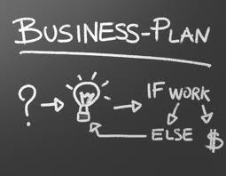
What is an Object?
Informally, an object represents an entity, either physical, conceptual, or software
Physical entity
Conceptual entity
Software entity
Truck
Linked List
Notes:
I believe you are quite familiar with the object-oriented concepts, I will go through these concepts quickly.

Slide 45
A More Formal Definition: An object is a concept, abstraction, or thing with sharp boundaries and meaning for an application
An object is something that has:
State
Behavior
Identity

Slide 46
What is a Class?
A class is a description of a group of objects with common properties (attributes), behavior (operations), relationships, and semantics
An object is an instance of a class
It defines the structure and behavior of each object in the class
It serves as a template for creating objects
Objects
Class
Professor
Professor Smith
Professor Mellon
Professor Jones
Notes:
A class has been called a “cookie cutter” for objects.

Slide 47
A class is an abstraction in that it:
Emphasizes relevant characteristics
Suppresses other characteristics
Notes:
We can not put ever properties into the class, otherwise it will become too complicated to manage.

Slide 48
Class
Course
Properties
Name
Location
Days offered
Credit hours
Start time
End time
Behavior
Add a student
Delete a student
Get course roster
Determine if it is full
a + b = 10

Slide 49
A class is comprised of three sections ( in UML)
The first section contains the class name
The second section shows the structure (attributes)
The third section shows the behavior (operations)
Class Name
Professor
name
Attributes
empID
Operations
create( )
save( )
delete( )
change( )
Notes:
In Rose:
You may select which compartments are displayed via Diagram Object Properties for the diagram element.
You may select which items appear in which compartments using the Edit Compartment function for the diagram element.

Slide 50
An object (sender) sends a request (message) to another object (receiver) to invoke a method of the receiver object’s.
A message is similar to a function call, but different
a message must somehow reference the intended recipient object
the recipient object only responds to the protocol, i.e., a predetermined set of messages defined by its class.
Data
Data
message
Fn
Fn
Sender object
Receiver object
Notes:
The interaction between two objects is achieved by message sending and receiving

Slide 51
Design Methodologies
Object-Orientation methodology
Objects are the building blocks of the program (interface object(editor, menu, file, etc), data managing object(db), etc.).
Objects represent real-world abstractions within the application.

Slide 52



Abstraction
Focus on the essential
Omits tremendous amount of details
…Focus on what an object “is and does”
Encapsulation
a.k.a. information hiding
a class encapsulates:
Structure: properties
Behavior: as a collection of methods invoked by messages

Slide 53
Inheritance: Automatic duplication of superclass attribute and behavior definitions in subclass.
Specialization: The act of defining one class as a refinement of another.
Subclass: A class defined in terms of a specialization of a superclass using inheritance.
Superclass: A class serving as a base for inheritance in a class hierarchy
Person
name
SSN
Student
Employee
std-id
emp-id
level
age

Slide 54
Abstract Class.
An incomplete superclass that defines common parts.
Not instantiated.
Concrete class.
Is a complete class.
Describes a concept completely.
Is intended to be instantiated.

Slide 55
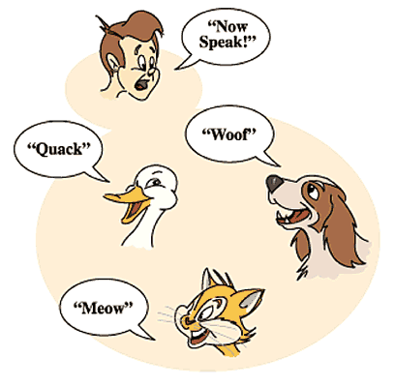
Polymorphism: Objects of different classes respond to the same message differently.
Notes:
In this picture, all objects have a method Speak() but each has a different implementation. Polymorphism allows you to do this, you can declare an action for a class and its subclasses but for each subclass, you can write exactly what you want later.

Slide 56
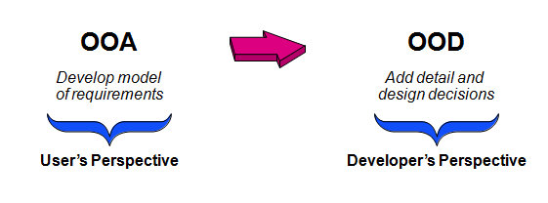
Object-oriented analysis (OOA) looks at the problem domain, with the aim of producing a conceptual model of the information that exists in the area being analyzed.
Object-oriented design is the process of planning a system of interacting objects for the purpose of solving a software problem
Notes:
Analysis models do not consider any implementation constraints that might exist, such as concurrency, distribution, persistence, or how the system is to be built. Implementation constraints are dealt during object-oriented design (OOD). Analysis is done before the Design.
Object-oriented design (OOD) transforms the conceptual model produced to take account of the constraints imposed by the chosen architecture and any non-functional – technological or environmental – constraints, such as transaction throughput, response time, run-time platform, development environment, or programming language

Slide 57
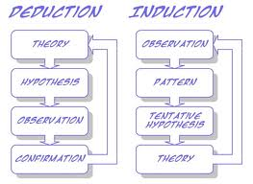
Object-orientation supports both
induction: objects -> a class
This needs the tools for OOA/OOD.
and deduction: a class ->objects
This needs the programmers to learn about the class library.
Notes:
From objects we can find the definition of class
And we can create multiple objects according to the definition of a class

Slide 58
Object-orientation supports both
Top-down: from a superclass to subclasses
Bottom-up: from subclasses to a superclass

Slide 59
Approximate Terminology
instance = object
field = instance variable
method = function
sending a message to an object = calling a function
These are all approximately true

Slide 60
(2) Hierarchy
We got abstractions and decomposition
This leads us to chunks (classes, objects) which we view with object model
Another way to deal with complexity is to provide simple relationships between the chunks
One of the most important relationships is hierarchy
2 important hierarchies
"Part of" hierarchy
"Is-kind-of" hierarchy

Slide 61
Part of Hierarchy
Computer
I/O Devices
CPU
Memory
Cache
ALU
Program
Counter

Slide 62
Is-Kind-of Hierarchy (Taxonomy)
Cell
Muscle Cell
Blood Cell
Nerve Cell
Striate
Smooth
Red
White
Cortical
Pyramidal

Slide 63
So where are we right now?
Three ways to deal with complexity:
Abstraction
Decomposition
Hierarchy
Object-oriented decomposition is a good methodology
Unfortunately, depending on the purpose of the system, different objects can be found
How can we do it right?
Many different possibilities
Our current approach: Start with a description of the functionality (Use case model), then proceed to the object model
This leads us to the software lifecycle
Notes:
The identification of objects and the definition of the system boundary are heavily intertwined with each other.

Slide 64
4.5 Software Engineering Concepts
Project
*
Activity
is produced by
*
consumes
WorkProduct
*
Task
*
Resources
System
Participant
Model
Time
Document
Equipment

Slide 65
5. Development Activities

Slide 66
5.1 Software Lifecycle Definition
Software lifecycle:
Set of activities and their relationships to each other to support the development of a software system
Typical Lifecycle questions:
Which activities should I select for the software project?
What are the dependencies between activities?
How should I schedule the activities?

Slide 67
5.2 Software Lifecycle Activities
Requirements
Elicitation
Analysis
System
Design
Object
Design
Implemen-
tation
Testing

Slide 68
5.3 object-oriented software engineering development activities and their products.
problem statement
Requirements
elicitation (
Ch.4)
nonfunctional requirements
functional model
use case diagram
Analysis (Ch.5)
class diagram
analysis object model
statechart diagram
dynamic model
System design
sequence diagram
(
Ch.6
& 7
)

Slide 69
System design (Ch. 6 & 7)
subsystem decomposition
design goals
Object design (Ch. 8 & 9)
class diagram
object design model
Implementation
(Ch. 10)
source code
Test (Ch. 11)
deliverable system

Slide 70
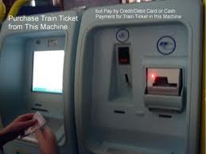
TicketDistributor
Travelers have the option of selecting a ticket for a single trip or for multiple trips, or selecting a time card for a day or a week
Compute the price
Handle exceptions
Notes:
In order to show the content of each activity clearly, let’s see an example.

Slide 71
(1) Requirement Elicitation
Use case name: PurchaseOneWayTicket
Participating actor: Initiated by Traveler
Flow of events:
The Traveler selects the zone in which the destination station is located
The TicketDistributor displays the price of the ticket
The Traveler inserts an amount of money that is at least as much as the price of the ticket
The TicketDistributor issues the specified ticket to the Traveler and returns any change
Entry condition: The traveler strands in front of the TicketDistributor, which may be located at the station of origin or at another station
Exit condition: The traveler holds a valid ticket and any excess change
Quality requirements: …

Slide 72
(2)Analysis//
:TicketDistributor
:Zone
:Balance
:Traveler
selectZone()
getPrice()
amountDue
insertChange()
updateBalance()
amountDue
insertChange()
updateBalance()
acknowledgement
:Ticket
«create»
printedTicket
Notes:
During analysis, we can define which objects participate in the interactions and their messages

Slide 73
Transaction
Ticket
Zone
results into
valid for
Coin
Balance
amount paid
Bill
Notes:
Then we can find the important concept, which will be modeled as class

Slide 74
(3) System Design
Traveler Interface
Updater
Local Tariff
Central Tariff
Notes:
During system design, how many components should be developed and how to organize the components into subsystem are considered

Slide 75
(4) Object Design
(5) Implementation
(6) Testing
Notes:
4. Developers define solution domain objects to bridge the gap between the analysis model and hardware/Software platform
5. Developers translate the solution domain model into source code
6. Input the sample data and try to find the faults

Slide 76
Summary
Software is already everywhere
Software engineering is a systematic, disciplined, quantifiable approach to the development, operation, and maintenance of software
Object-oriented methodology is an effective way to deal with the complexity

Slide 77
Thanks cao-jian@cs.sjtu.edu.cn
* Some materials come from Bernd Bruegge & Allen H. Dutoit’s PPT and others from Internet
Notes:
Now let’s go to the second lecture

